Slide 1

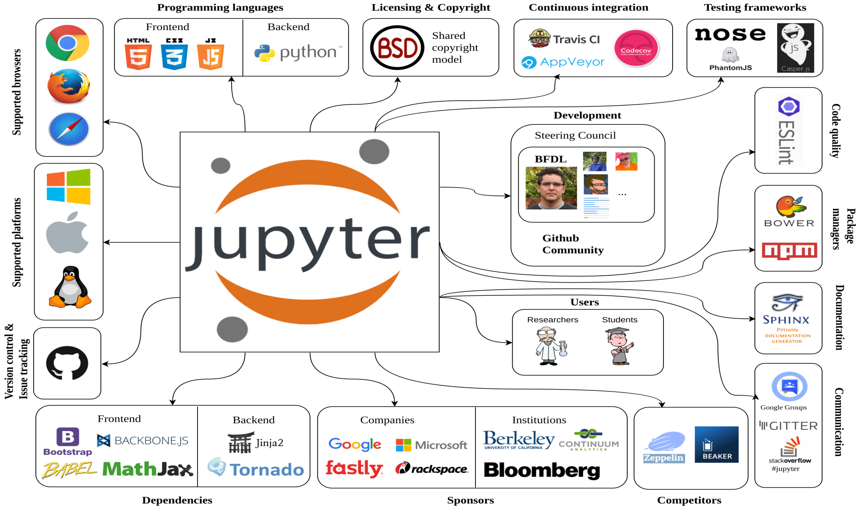
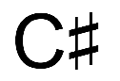


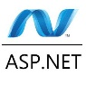


Slide 2
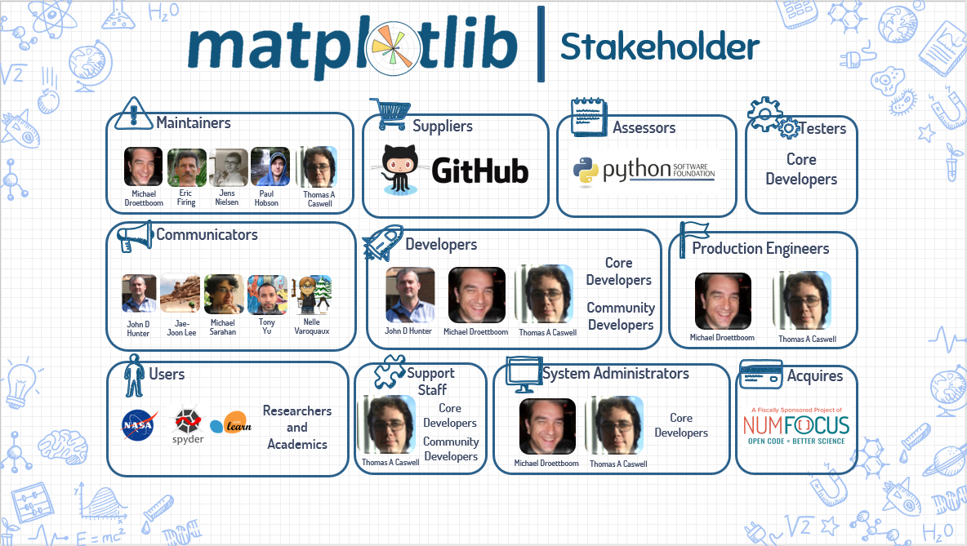

Slide 3
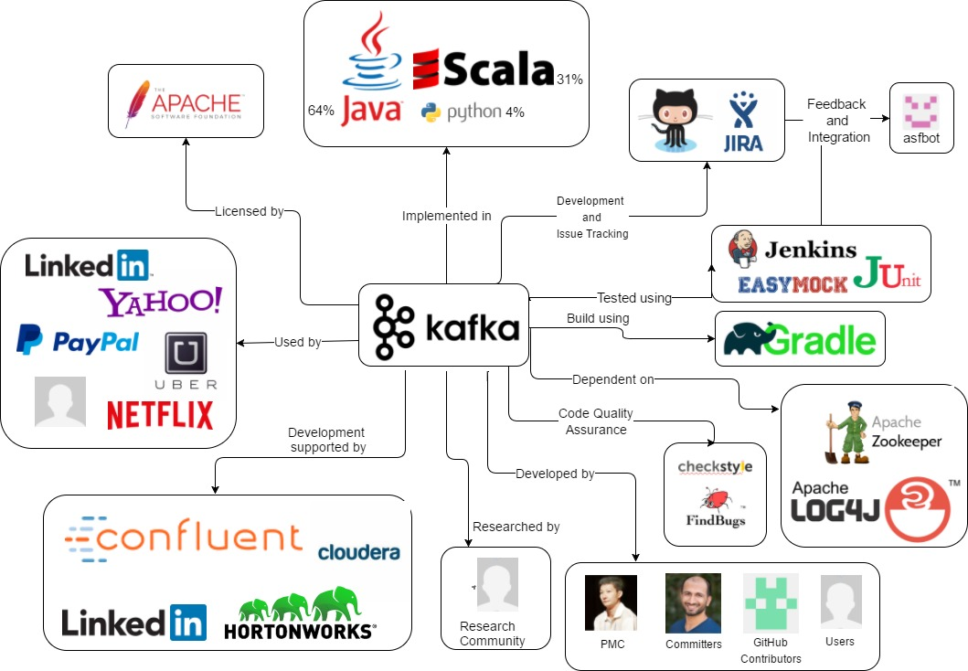

Slide 4
Visualization
Platforms
Dependencies
Testing
Version control + issue track
Dev. Environment
Collaborators
Data Storage
Languages used
Developers
Backers

Slide 5
Visualization
Platforms
Dependencies
Testing
Version control + issue track
Dev. Environment
Collaborators
Data Storage
Languages used
Developers
Backers

Slide 9
Manager
git contributors

Slide 12
Supported Browsers
Supported Mobile Devices

